Slide 1

Intro to Karst Modelling Sarah Pederzani StalFire PSM workshop, University of Utah 17.01.2025

Slide 2
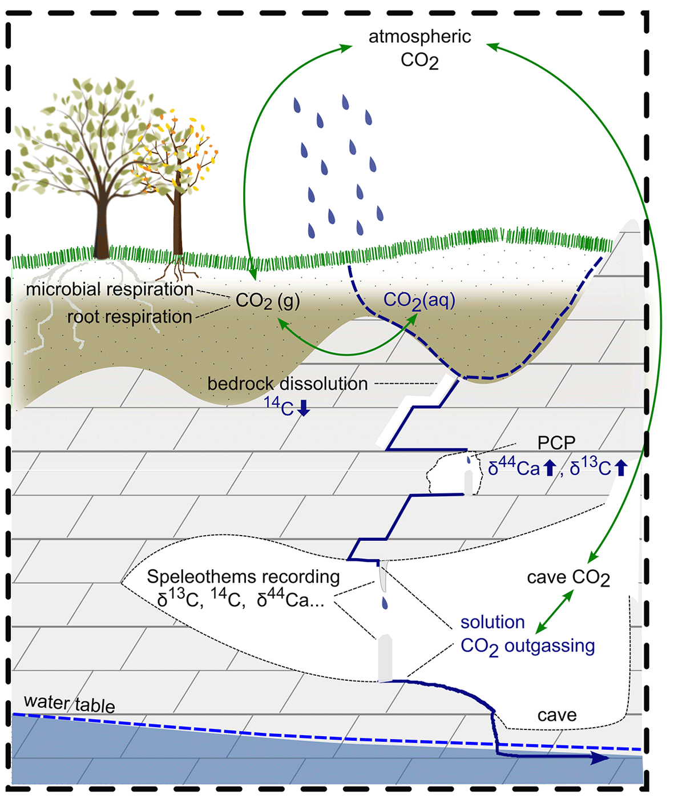
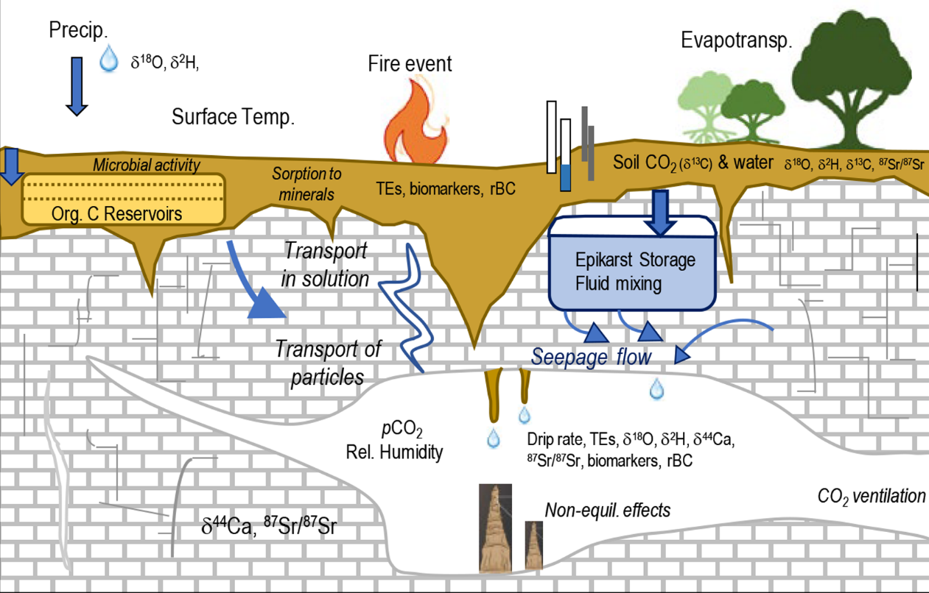
Why karst/stalagmite modelling?
Figure by G. Bowen
Lechleitner et al., 2021

Slide 3
Why karst/stalagmite modelling?
Climate forcings are heavily transformed from the surface to the stalagmite
Expression of forcings in proxy signals is different for each cave and stalagmite
Models are used to constrain and describe these transformations
Goal: more robust and potentially more quantitative palaeoclimate interpretations
Figure by G. Bowen

Slide 4
Common components of karst models
Plant-Soil System
Hydrology
Evaporation
Storage
Mixing
Flowpaths
Drip rates
Carbonate chemistry
Soil pCO₂
Host-rock dissolution
PCP
TE chemistry
Host-rock composition
Water-host rock interaction
Soil contribution
Karst System
In-Cave processes
Calcite formation
Fractionation
Cave T, pCO₂
Non-eq. effects

Slide 5
An (incomplete) overview of models
(Plant)-Soil System
KarstFor
CaveCalc
ODSM
KarstSolution
δ¹⁸O
δ¹⁸O
δ¹⁸O
δ¹⁸O
δ¹³C
TEs
Karst System
KARSTMOD
discharge
In-Cave processes
ISOLUTION
I-STAL
CaveCalc
ODSM
δ¹⁸O
δ¹⁸O
δ¹⁸O
Mg, Sr, Ba
δ¹³C
δ¹³C
TEs

Slide 6
An (incomplete) overview of models
A vast range of models exists
Mathematical and conceptual implementations can differ widely
Large range of complexities
Most focus on one component of interest
Vast majority of models treat δ¹⁸O and δ¹³C at most, some represent trace elements

Slide 7

Hydrology modelling

Slide 8

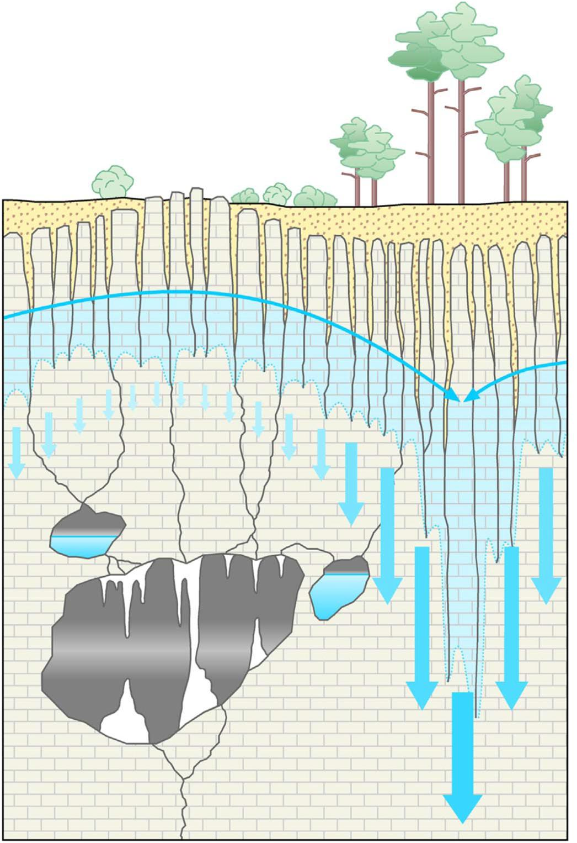
Processes we need to represent
precipitation
evapotranspiration
soil water
water storage
time delay
water flow
mixing
drip rate

Slide 9
Storages – time step approach
I
Inflow
I
S
Volume of storage
S
Outflow
Q2
Q
Q1
S_{t+1} = S_{t} + I_{t} – Q_{t}
S_{t+1} = S_{t} + ΣI_{t} – ΣQ_{t}
S_{t+1} = S_{t} + I_{t} – Q1_{t} – Q2_{t}

Slide 10
Types of water flows
Underflow
Overflow
Lateral flow
S_{max}
Q
S
S
S1
Q1
S2
Q
S_{min}
S
Q

Slide 11
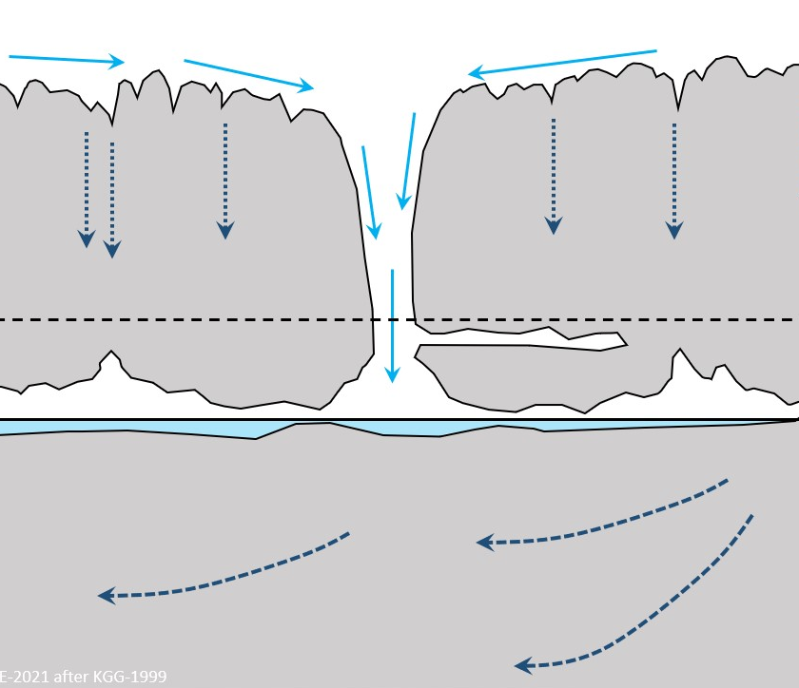
Flow modes
Fracture flow
Matrix flow
Fast flow in larger fractures
Assumed to be well-mixed
Low residence time
Difficult to reach max capacity
Slow flow through small fractures and the matrix
Less mixing/piston flow
higher residence time
Easier to reach saturation

Slide 12
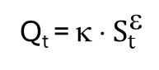
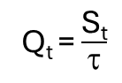
Routing/discharge functions
Linear
Power law
I
Q
Q
concave
convex
S
S
S
Q
Q_{t} = α ⋅ S_{t}
Q_{t} = κ ⋅ $S_{t}^{}$
S_{t+1} = S_{t} + I_{t} – Q_{t}
Q_{t} = $\frac{\text{S}\text{t}}{τ}$
ε < 1 concave & ε > 1 convex

Slide 13
Modelling drip rates
Match discharge estimates to cave monitoring observations
Estimate film residence time on the stalagmite
Dimensionless factor
Drop mass model
Drip rate interpolation
Simple Simple Matched to cave observations | Mechanistic Based on empirical data from many caves Tailored to drip site geometry | Simple Simple Somewhat mechanistic Matched to cave observations
Not mechanistic Only allows constant linear relationship with discharge | Complicated Many nuisance parameters Necessary information may not be available | Not mechanistic Only allows constant linear relationship with storage volume (and discharge)
Drip rate
Drop mass
Drop mass
Drip rate
D_{min}
Discharge
Drip interval
Tube radius
Discharge
Pros
Cons
Current StalFire model
Collister & Mattey, 2008
Treble & Deininger, 2019

Slide 14
The soil layer
precipitation
Prcp_{t}
ET
S_{max}
Runoff
evapotranspiration
S_soil_{t}
mixing
soil water
water storage
Infil_{t}
water flow
Storage, discharge, and routing relationships apply
Special dynamics: evapotranspiration, runoff

Slide 15
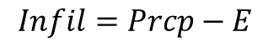
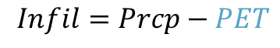
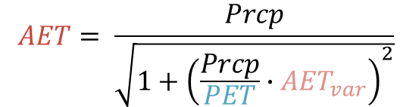
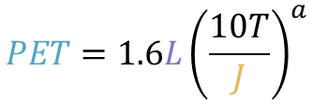
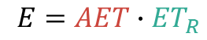
Soil layer - Evapotranspiration
Water loss
$$PET=1.6L{\left(\frac{10T}{J}\right)}^{a}$$
evapotranspiration
$$E=AET∙{ET}_{R}$$
Actual evapotranspiration
Soil water E/T ratio
AET noise term
Potention evapotransporation
Day length
Monthly heat index
soil water
$$AET= \frac{Prcp}{\sqrt{1+{\left(\frac{Prcp}{PET}∙{AET}_{var}\right)}^{2}}}$$
$$Infil=Prcp−PET$$
or
$$Infil=Prcp−E$$
PET as function of T and solar radiation
Fischer-Femal & Bowen, 2021
Thornthwaite, 1948

Slide 16
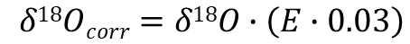
Soil layer - Evapotranspiration
evapotranspiration
Isotopic fractionation
Karst models commonly use a fixed isotopic evaporation coefficient to model evaporative fractionation
soil water
$$δ18Ocorr=δ18O∙\left(E∙0.03\right)$$
Bradley et al., 2010
Mixing
S_soil_{t}
S_soil_{t}
well mixed
evaporation front

Slide 17
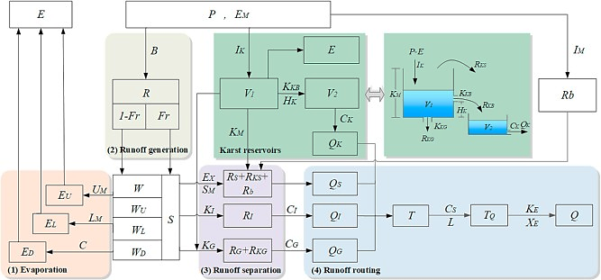
Soil layer - Runoff
Runoff generation models of karst systems can be highly complex
Consideration for example of soil moisture storage capacity, different runoff types etc
Prcp_{t}
ET
S_{max}
Runoff
S_soil_{t}
Infil_{t}
Almost never explicitly modelled in stalagmite models
In its simplest form a special case of storage overflow
Zhou et al., 2019

Slide 18
Common features of stalagmite models
Linear discharge functions
Multiple storages & flow modes
Highly simplified soil layer
Prcp_{t}
E
S_{max}
S_soil_{t}
Q
Infil_{t}
S
well mixed
Simplified evaporation
Fixed evaporative enrichment coefficients
Mathematical representations of hydrology often very simplified. More complex, non-linear behavior usually achieved by introducing multiple levels of storages, flow modes and discharge thresholds.

Slide 19
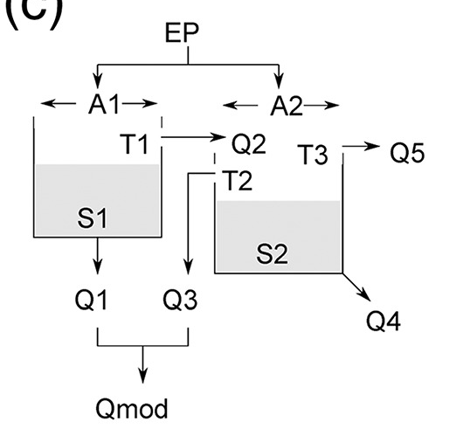
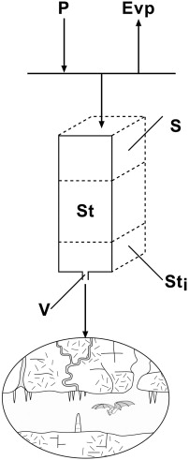
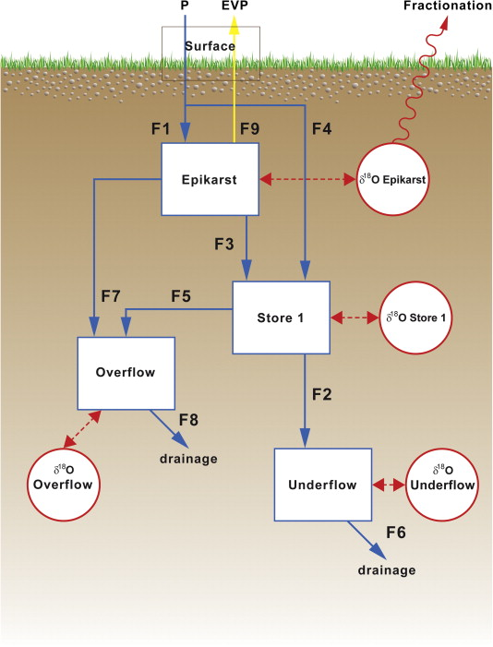
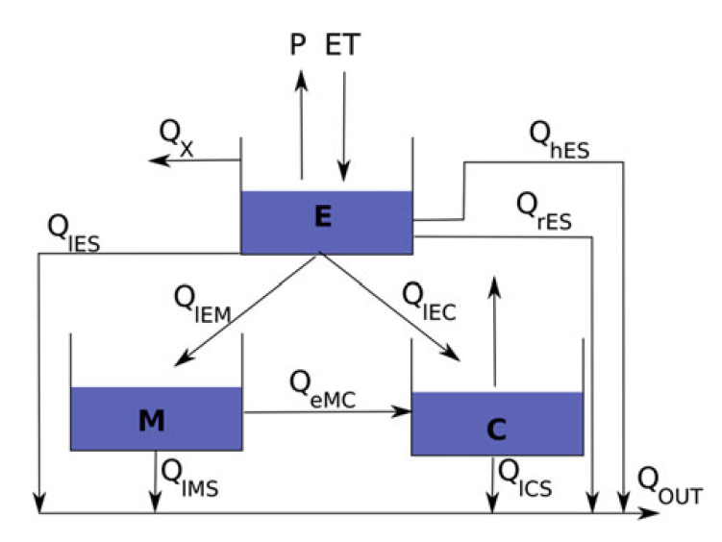
Example karst hydrology models
Baker & Bradley, 2010
Campbell et al., 2017
KarstFor
Karstmod
Bradley et al., 2010
Jourde et al., 2015

Slide 20

Mixing model fundamentals

Slide 21
Mixing of water – mixing of tracers
Stalagmite models usually assume well-mixed storages that give rise to water discharge with the tracer composition of the storage of origin
soil water
water storage
water flow
mixing

Slide 22
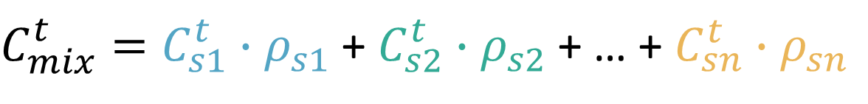
Linear mixing models
The tracer composition of the mixture is a function of the composition of each source and the relative amount contributions of the sources
Tracer
concentration
Fraction of mix
$C_{mix}^{t}=C_{s1}^{t}∙ρ_{s1}$ + $C_{s2}^{t}∙ρ_{s2}$ + … + $C_{sn}^{t}∙ρ_{sn}$
Source 1
Source 2
Source n
Mixing models can account for time lags, but stalagmite models usually consider storages to be instantly well-mixed

Slide 23

Carbonate geochemistry and calcite formation

Slide 24
Learning goals
What are some processes that can be important to represent?
What are some common models?
What components do they focus on?
End goal: know where to look for math to implement your model components

Slide 25

A very brief overview of processes

Slide 26
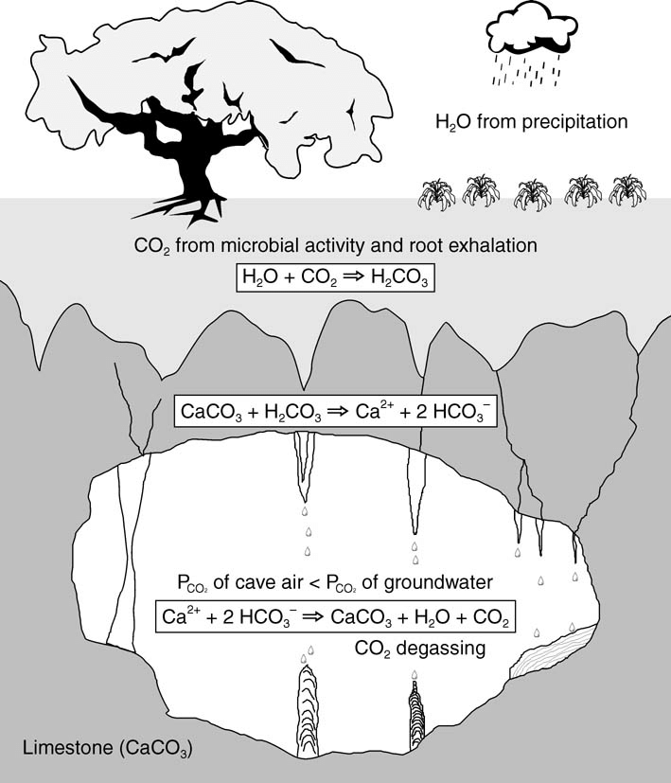
From water and CO₂ to calcite
Acidulation
Dissolution
Precipitation
Fleitmann et al., 2004
Lechleitner et al., 2021

Slide 27
Initial solution geochemistry
Models usually focus on the (isotope) chemistry of the solution
Normally use δ¹³C of soil gas and atmospheric CO₂ as inputs
Initial solution
- ionic chemistry
- stable isotopes
CO₂ uptake
Host rock dissolution
Soil contributions
Chemical equilibrium concentration calculations and isotopic fractionation/exchange

Slide 28
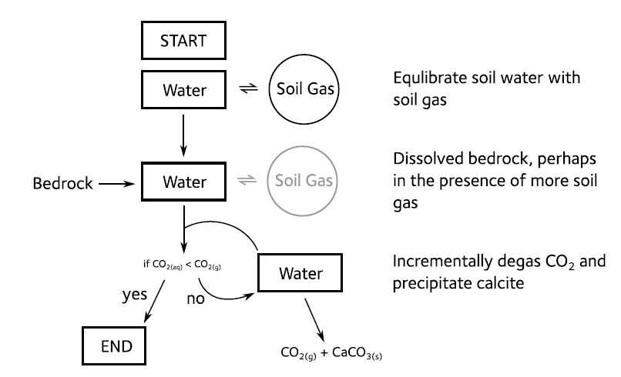
Solution geochemistry
A conceptual overview from the CaveCalc model
Contact with soil gas
= open system
No contact
= closed system

Slide 29
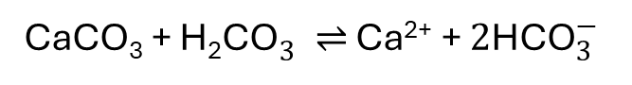
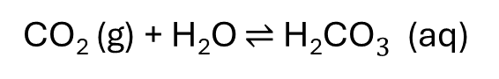
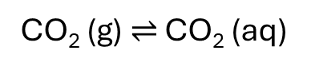
Solution geochemistry
$${\text{Ca}}^{2+}+2{\text{HCO}}_{3}^{−} \text{⇌} {\text{CaCO}}_{3}+{\text{CO}}_{2}+{\text{H}}_{2}\text{O}$$
CO₂ (g) $\text{⇌}$ CO₂ (aq)
CO₂ (g) + H₂O $\text{⇌}$ ${\text{H}\text{2}\text{CO}}_{3}^{}$ (aq)
carbonic acid
CaCO₃ + ${\text{H}\text{2}\text{CO}}_{3}^{} \text{⇌} \text{Ca}\text{2+}\text{ + }2{\text{HCO}}_{3}^{−}$
calcite
bicarbonate

Slide 30
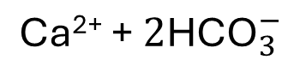
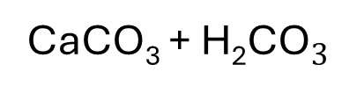
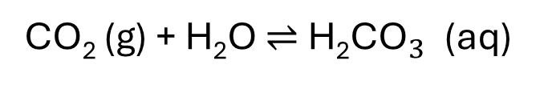
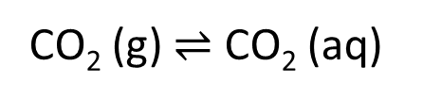
Solution geochemistry
$${\text{Ca}}^{2+}+2{\text{HCO}}_{3}^{−} \text{⇌} {\text{CaCO}}_{3}+{\text{CO}}_{2}+{\text{H}}_{2}\text{O}$$
CO₂ (g) $\text{⇌}$ CO₂ (aq)
CO₂ (g) + H₂O $\text{⇌}$ ${\text{H}\text{2}\text{CO}}_{3}^{}$ (aq)
CaCO₃ + ${\text{H}\text{2}\text{CO}}_{3}^{}$
$$\text{Ca}\text{2+}\text{ + }2{\text{HCO}}_{3}^{−}$$

Slide 31
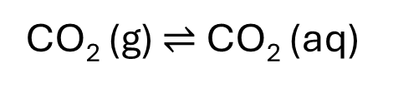
Solution geochemistry
$${\text{Ca}}^{2+}+2{\text{HCO}}_{3}^{−} \text{⇌} {\text{CaCO}}_{3}+{\text{CO}}_{2}+{\text{H}}_{2}\text{O}$$
pCO₂ ↑
CO₂ (g) $\text{⇌}$ CO₂ (aq)
CO₂ (g) + H₂O $\text{⇌}$ ${\text{H}\text{2}\text{CO}}_{3}^{}$ (aq)
CaCO₃ + ${\text{H}\text{2}\text{CO}}_{3}^{}$
$$\text{Ca}\text{2+}\text{ + }2{\text{HCO}}_{3}^{−}$$
Calcite dissolution ↑

Slide 32
Solution geochemistry
$${\text{Ca}}^{2+}+2{\text{HCO}}_{3}^{−} \text{⇌} {\text{CaCO}}_{3}+{\text{CO}}_{2}+{\text{H}}_{2}\text{O}$$
CO₂ gasses out
Exposure to cave air
pCO₂ ↓
CO₂ (g) $\text{⇌}$ CO₂ (aq)
CO₂ (g) + H₂O $\text{⇌}$ ${\text{H}\text{2}\text{CO}}_{3}^{}$ (aq)
CaCO₃ + ${\text{H}\text{2}\text{CO}}_{3}^{}$
$$\text{Ca}\text{2+}\text{ + }2{\text{HCO}}_{3}^{−}$$
Calcite precipitates

Slide 33
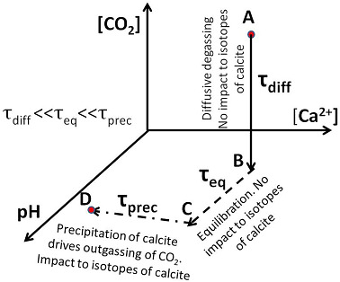
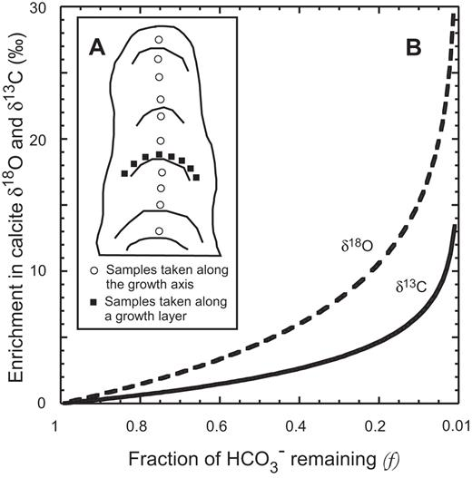
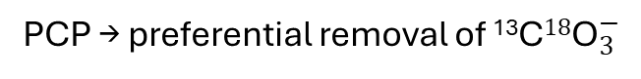
Isotopic fractionation
Equilibrium
CO₂-Calcite-bicarbonate equilibrium fractionations
Disequilibrium
Rapid degassing → preferential escape of ¹²C¹⁶O₂
PCP → preferential removal of ¹³${\text{C}18\text{O}}_{3}^{−}$
Dreybrodt & Fohlmeister, 2022
Mickler et al., 2006

Slide 34
Major modelling components
Soil CO₂
Respiration rates, pCO₂
Atmospheric CO₂
δ¹³C of soil CO₂
Host rock dissolution
PCP
Calcite & Dolomite dissolution
Open vs closed systems
Host rock heterogeneity
CO₂ degassing in relation to water availability
Calcite precipitation
Isotopic fractionation
Calcite precipitation
Cave atmosphere
CO₂(g)-DIC equilibrium
CO₂ degassing
Calcite precipitation
Isotopic fractionation
Growth rates
Cave pCO₂
Cave temperature
Lechleitner et al., 2021
Calculations for ionic concentrations and isotopic effects are very well explored
Models mostly differ in which effects they account for and the degree of complexity of the implementation

Slide 35
A few prominent models
 | ISOLUTION (C, O) | CaveCalc (C, O, TE) | I-STAL (TE, Ca)
Soil compartment |  | CO2 (g) – CO2(aq) equilibrium δ¹³C, CO₂ mixing mechanistic solution chemistry (PHREEQC) | Estimate initial Ca and TE content of dripwater Variable soil/vs host rock contributions considered
Host rock dissolution |  | Open or semi-open system Calcite reprecipitation mechanistic solution chemistry (PHREEQC) | Estimate initial Ca and TE content of dripwater
PCP |  | Incoporated as multi-step degassing process mechanistic solution chemistry (PHREEQC) | Loss of Ca and TEs during PCP
Cave atmosphere | Cave atmosphere as input Considers extensive range of parameters | Cave atmosphere as input | Cave atmosphere as input
Calcite precipitation | disequilibrium effects Evaporation inside the cave Drop splashing effects | degassing modes mechanistic solution chemistry (PHREEQC) | Calcite deposition rates TE, Ca partitioning

Slide 36
Major modelling components
Soil CO₂
Focus of existing models
Respiration rates, pCO₂
Atmospheric CO₂
δ¹³C of soil CO₂
Host rock dissolution
PCP
Calcite & Dolomite dissolution
Open vs closed systems
Host rock heterogeneity
CO₂ degassing in relation to water availability
Calcite precipitation
Isotopic fractionation
Calcite precipitation
Cave atmosphere
CO₂(g)-DIC equilibrium
CO₂ degassing
Calcite precipitation
Isotopic fractionation
Growth rates
Cave pCO₂
Cave temperature
Lechleitner et al., 2021

Slide 37

Where to find starting points

Slide 38
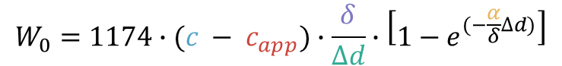
Growth models
Expression in terms of pCO₂
Expression in terms of [Ca²⁺]
$$W_{0}=1174∙(c − c_{app})∙\frac{δ}{∆d}∙\left[1−e^{(−\frac{α}{δ}∆d)}\right]$$
$$W_{0}=1174∙(\left[{Ca}^{2+}\right]− {\left[{Ca}^{2+}\right]}_{app})∙\frac{δ}{∆d}∙\left[1−e^{(−\frac{α}{δ}∆d)}\right]$$
pCO2 of droplets
Ca concentration
Apparent eq. pCO₂ of cave air
Apparent eq. Ca concentration of drip water
Water film thickness
Drop interval
Rate constant
Treble & Deininger, 2019 - KarstSolution
Baker et al., 2014

Slide 39
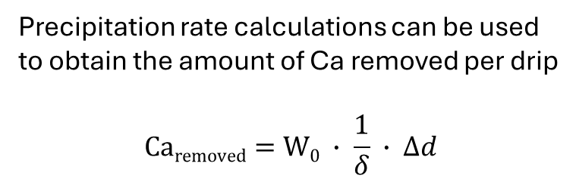
Calcium concentration
Estimating initial drip water [Ca²⁺]
Calcite precipitation
Empirical relationship between surface climate and monitoring drip [Ca²⁺]
Precipitation rate calculations can be used to obtain the amount of Ca removed per drip
$$\text{Ca}\text{removed}=\text{W}0 ∙ \frac{1}{δ} ∙ ∆d$$
e.g. Baker et al., 2014
Use activity coefficients and mass action constants to obtain the concentrations of all species in the CaCO₃–H₂O–CO₂ system under changing pCO₂ conditions
Stoll et al., 2012 I-STAL
Hendy, 1971; Fohlmeister, 2011
Thermodynamic calculations of ionic chemistry evolution are complex and often outsourced to chemical speciation software (e.g. PHREEQC)

Slide 40
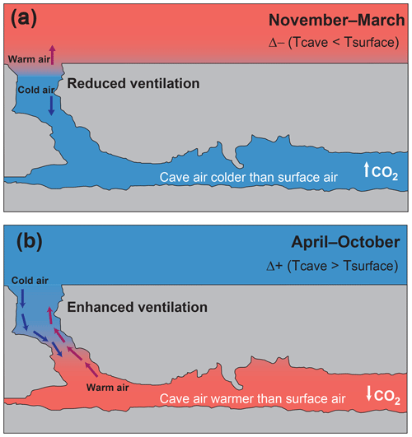
Cave atmosphere
Seasonal patterns in cave air pCO₂ can sometimes be predicted through empirical correlation with surface temperature and soil pCO₂
CO₂ supply to the cave ultimately comes from soil CO₂
Lagged time series of soil CO₂ from temperature-dependent efflux models can broadly reproduce seasonal cave pCO₂ patterns
Baldini et al., 2020
Nava-Fernandez et al., 2020

Slide 41

The end…

